Slide 1

CPE 602 Final project
Sit Dolor Amet

Slide 2
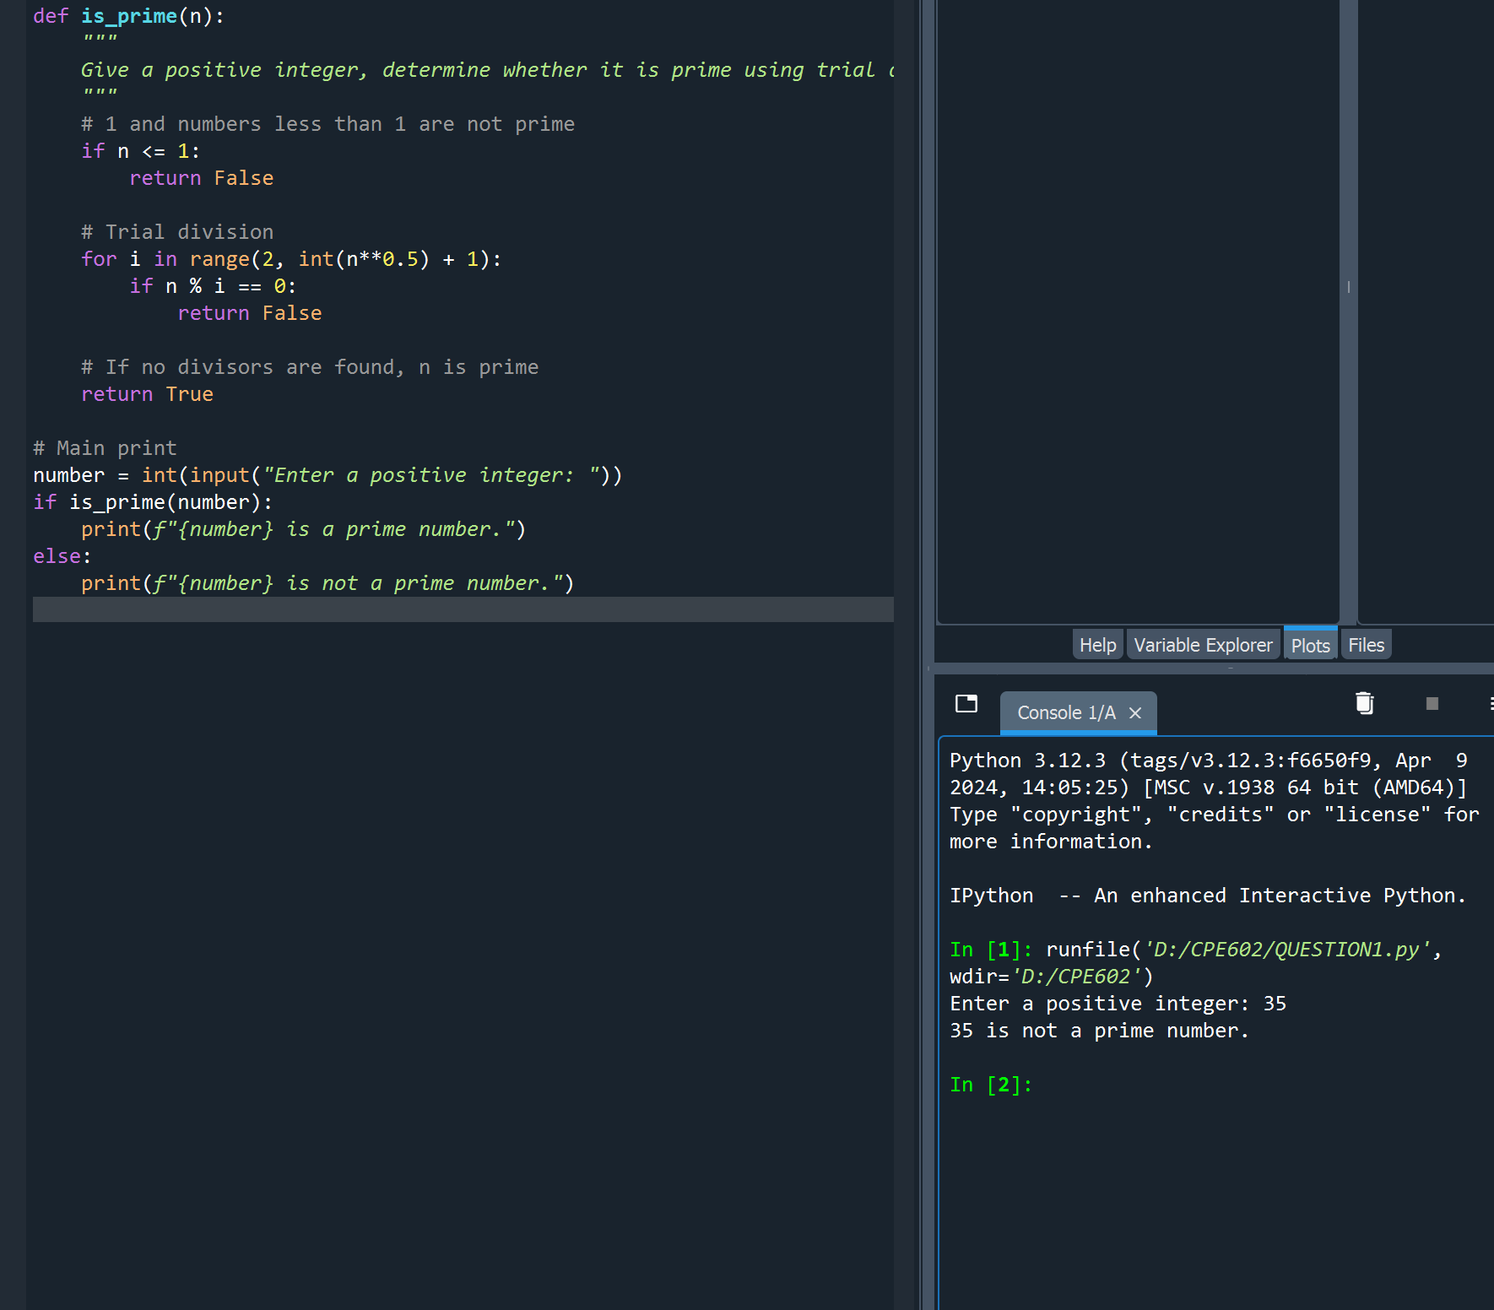
Question 1

Slide 3
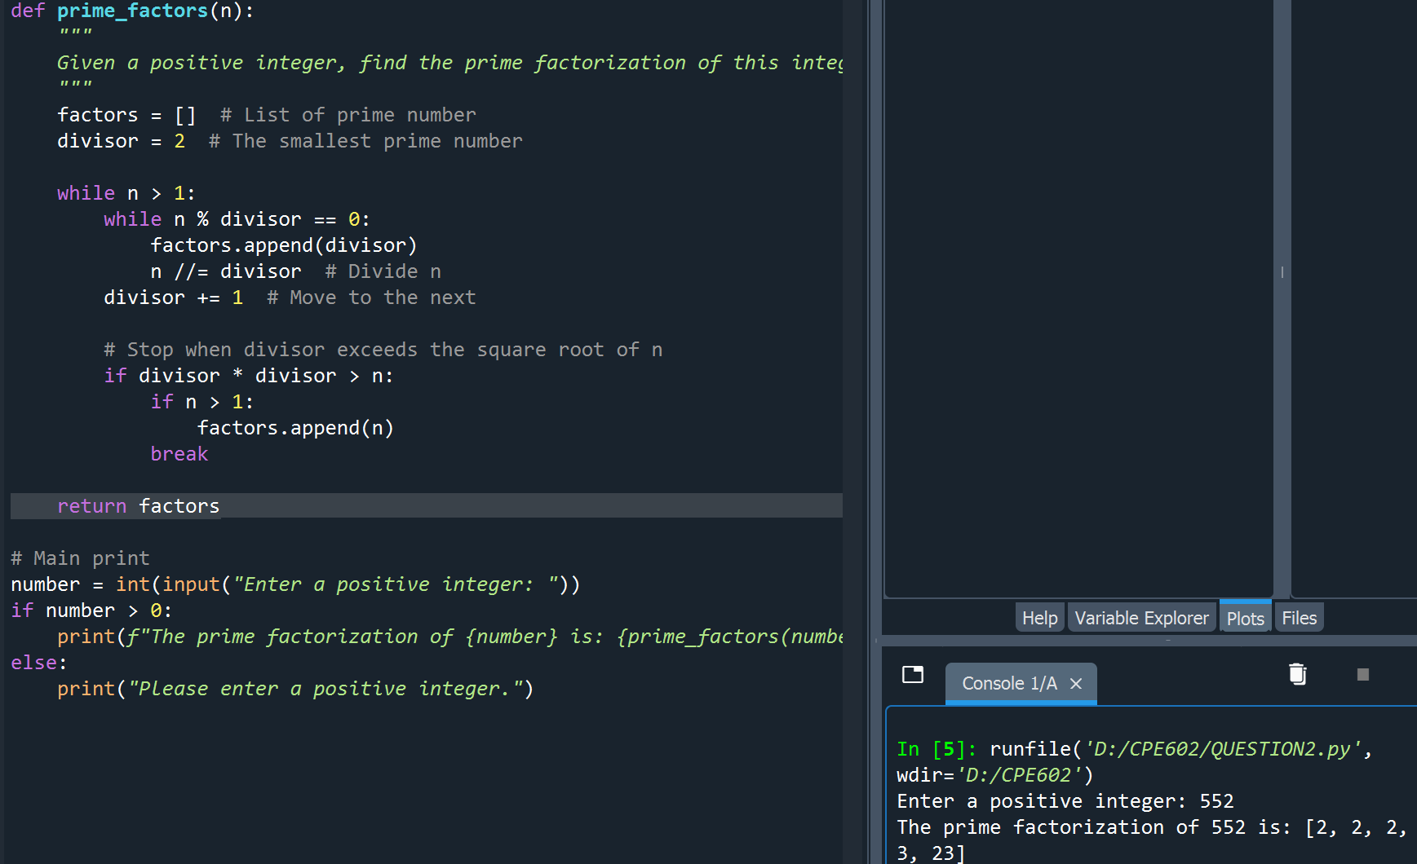
Question 2

Slide 4
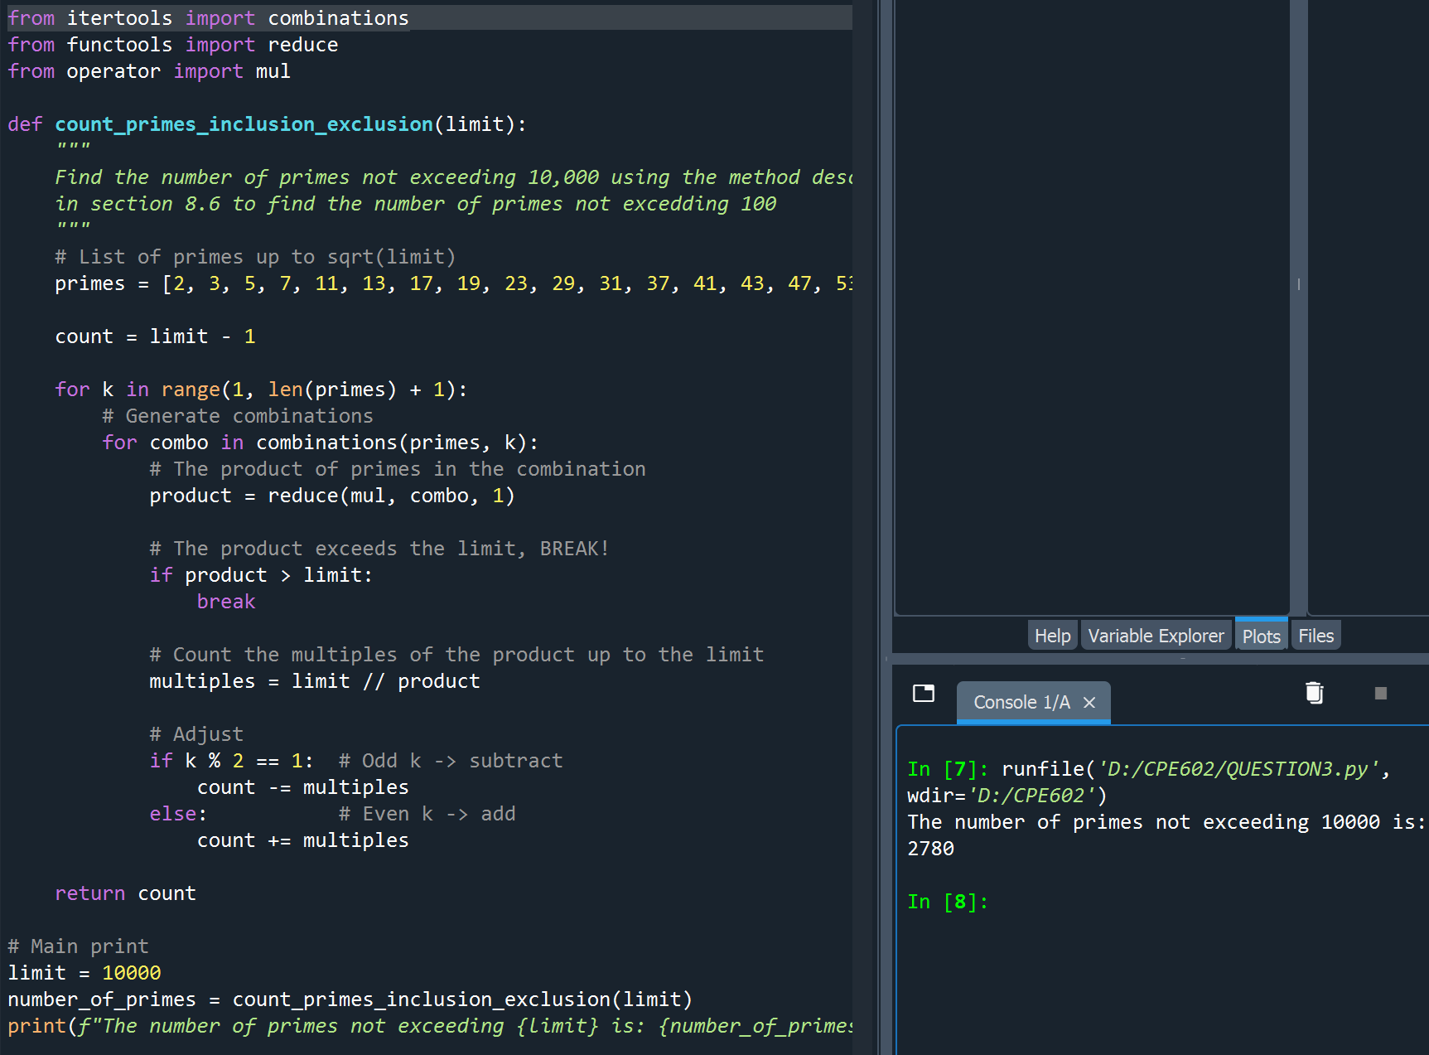
Question 3

Slide 5
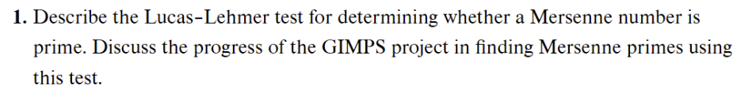
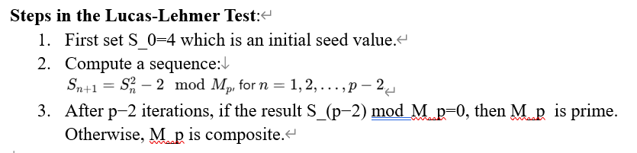
Question 5

Slide 6
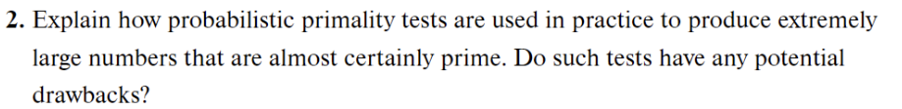
Question 6
Practical uses of the probabilistic prime test:
Large Number Efficiency: These tests are computationally efficient and suitable for very large numbers.
There is a certain degree of certainty: while prime numbers are not guaranteed, they can achieve an extremely low probability of error.
Iterative Confidence: By running the test multiple times using different parameters (such as the base in Miller-Rabin).
shortcoming:
Non-zero error rate: they may incorrectly identify composite numbers as prime
Non-deterministic: Unlike deterministic tests, they do not provide absolute proof of prime numbers but rather probabilistic guarantees.
Complex numbers and special cases: Certain specially constructed numbers, such as pseudoprimes and Carmichael numbers, can pass these tests, complicating their reliability

